Slide 1
eps | minpts | noise points | value counts
1.8 | 9 | 183 | [977, 16]
1.8 | 10 | 195 | [968, 13]
1.8 | 11 | 209 | [954, 13]
1.8 | 12 | 209 | [945, 13]
1.9 | 9 | 128 | [1048]
1.9 | 10 | 134 | [1042]
1.9 | 11 | 158 | [1003, 15]
1.9 | 12 | 166 | [994, 16]
 | Age
count | 1176
mean | 37.199000
std | 9.015802
min | 18.000000
25% | 30.000000
50% | 36.000000
75% | 43.000000
max | 60.000000
 | Enviroment Satisfaction(%) | Job Involvement (%) | Job Satisfaction (%) | Performance Rating (%) | Relationship Satisfaction (%) | Worklife Balance (%)
Low | 19.2177 | 5.5272 | 19.9830 | 00.0000 | 19.3878 | 5.6973
Medium | 19.8129 | 25.7653 | 19.9830 | 00.0000 | 20.7483 | 23.1293
High | 29.8469 | 58.3333 | 29.8469 | 84.7784 | 30.1020 | 61.0544
Excellent | 31.1224 | 10.3741 | 30.1871 | 15.2216 | 29.7619 | 10.1190

Slide 2
val | class | Distribution (%)
1 | Below college | 11.8197
2 | College | 19.8980
3 | Bachelor | 39.0306
4 | Master | 26.5306
5 | Doctor | 2.7211
JobRole | Distribution (%)
Sales Executive | 22.1939
Research Scientist | 20.4082
Laboratory Technician | 18.0272
Manufacturing Director | 9.7789
Healtcare Rapresentative | 9.0136
Manager | 6.8878
Sales Rapresentative | 5.8673
Research Director | 4.3367
Human Resource | 3.4864
JobLevel | Distribution (%)
1 | 37.925
2 | 36.479
3 | 14.881
4 | 6.972
5 | 3.741

Slide 3
 | HourlyRate | DailyRate | MonthlyRate | MonthlyIncome | PercentSalaryHike
count | 1176 | 1176 | 1176 | 963 | 1176
mean | 66.2993 | 803.6505 | 14395.8367 | 6565.9460 | 15.1768
std | 20.2661 | 406.6830 | 7111.8451 | 4710.6256 | 3.6239
min | 30.0000 | 102.0000 | 2097.0000 | 1009.0000 | 11.0000
25% | 49.0000 | 460.5000 | 8227.2500 | 2969.0000 | 12.0000
50% | 66.0000 | 804.0000 | 14434.0000 | 4969.0000 | 14.0000
75% | 84.0000 | 1169.0000 | 20489.2500 | 8585.0000 | 18.0000
max | 100.0000 | 1499.0000 | 26999.0000 | 19999.0000 | 25.0000
 | MonthlyIncomeTransf
count | 1176
mean | 8.59
std | 0.61
min | 6.91
25% | 8.14
50% | 8.56
75% | 8.98
max | 9.90
Attribute | Age | Business Travel | Gender | Monthly Income | Over18 | Performance Rating | Standard Hours | TrainingTime LastYear | YearsAt Company
Missing Values | 176 | 107 | 59 | 213 | 372 | 138 | 570 | 233 | 60

Slide 4
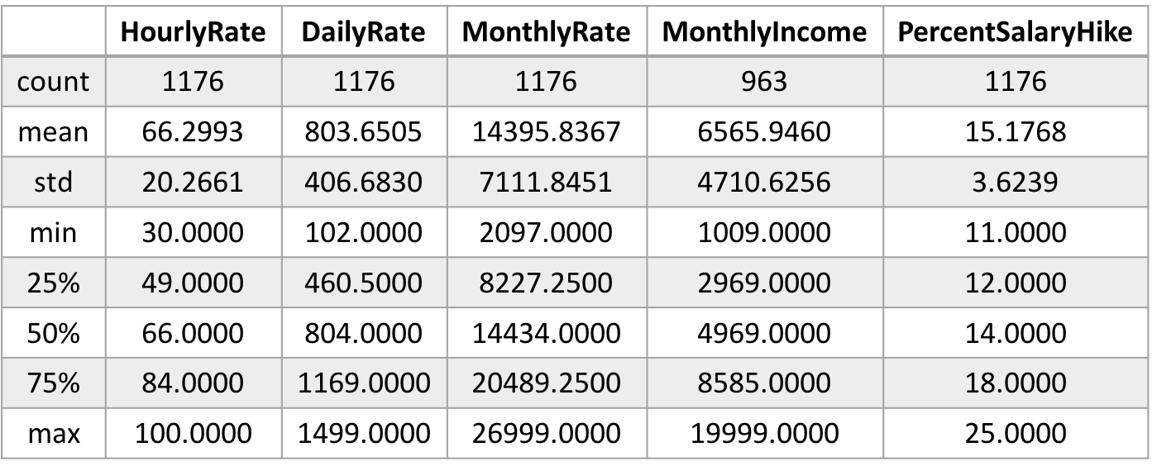
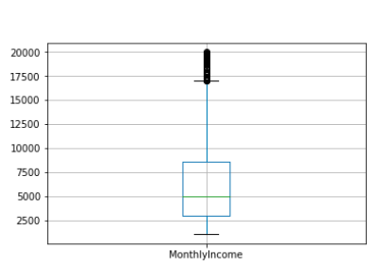



Attribute | Monthly Income | NumCompanies Worked | TotalWorking Year | TrainingTimes LastYear | YearsAt Company | YearsIn CurrentRole | YearsSince LastPromotion | YearsWith CurrManager
Outliers | 89 | 40 | 49 | 152 | 75 | 17 | 85 | 11
Thresholds Q1-1.5*IQR, Q3+1.5*IQR | [-3343.875, 14775.125] | [-3.5, 8.5] | [-7.5, 28.5] | [0.5,4.5] | [-6.0, 18.0] | [-5.5, 14.5] | [-4.5, 7.5] | [-5.5, 14.5]
Domain | [0, 19999] | [0, 9] | [0, 40] | [0, 6] | [0, 40] | [0, 18] | [0, 15] | [0, 17]

Slide 5
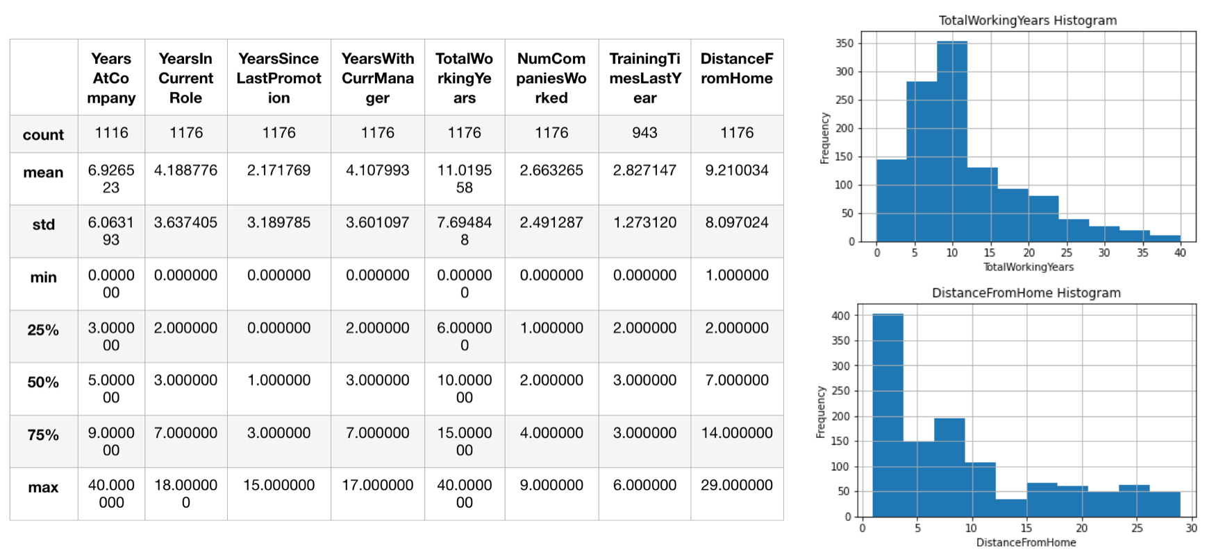
 | YearsAt Company | YearsIn CurrentRole | YearsSince LastPromotion | YearsWithCurr Manager | TotalWorking Years | NumCompanies Worked | TrainingTimes LastYear | Distance FromHome
count | 1116 | 1176 | 1176 | 1176 | 1176 | 1176 | 943 | 1176
mean | 6.9265 | 4.1887 | 2.1717 | 4.1079 | 11.0195 | 2.6632 | 2.8271 | 9.2100
std | 6.0631 | 3.6374 | 3.1897 | 3.6010 | 7.6948 | 2.4912 | 1.2731 | 8.0970
min | 0.0000 | 0.0000 | 0.0000 | 0.0000 | 0.0000 | 0.0000 | 0.0000 | 1.0000
25% | 3.0000 | 2.0000 | 0.0000 | 2.0000 | 6.0000 | 1.0000 | 2.0000 | 2.0000
50% | 5.0000 | 3.0000 | 1.0000 | 3.0000 | 10.0000 | 2.0000 | 3.0000 | 7.0000
75% | 9.0000 | 7.0000 | 3.0000 | 7.0000 | 15.0000 | 4.0000 | 3.0000 | 14.0000
max | 40.0000 | 18.0000 | 15.0000 | 17.0000 | 40.0000 | 9.0000 | 6.0000 | 29.0000

Slide 6
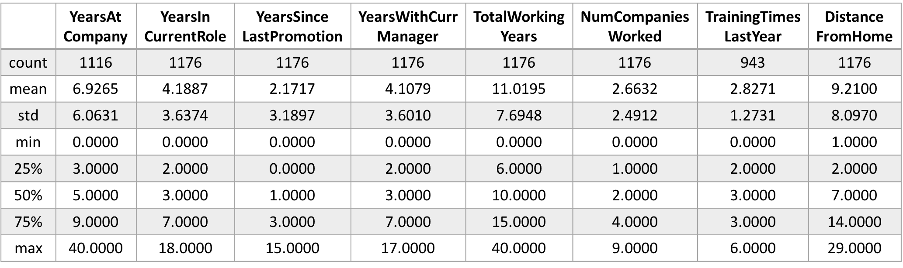

Slide 7
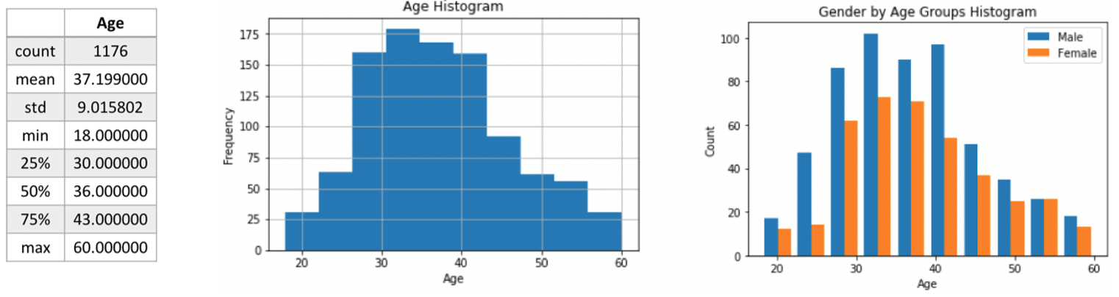

Slide 8
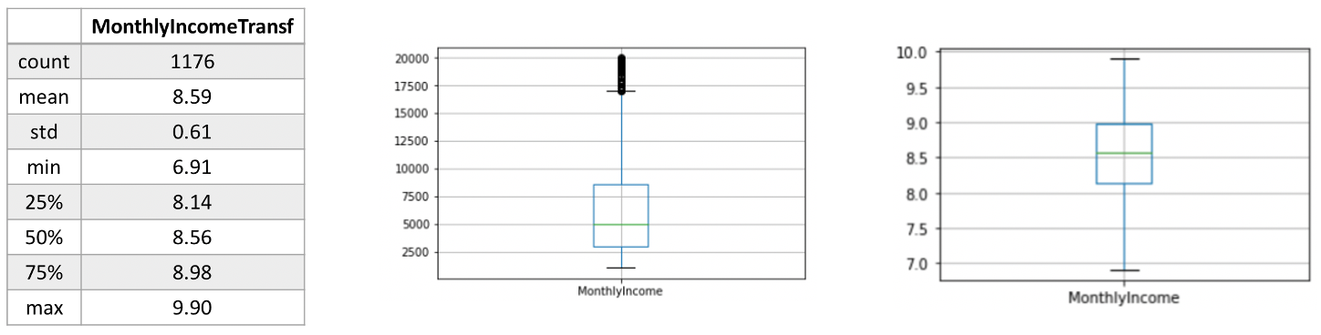

Slide 9
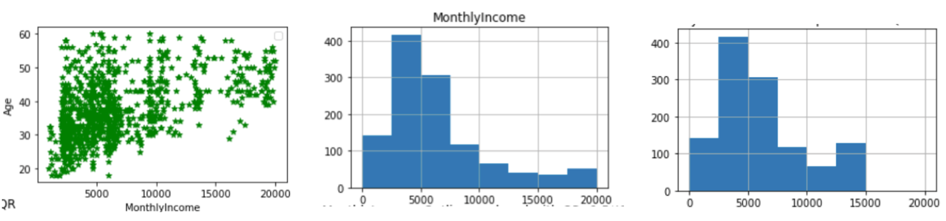

Slide 10
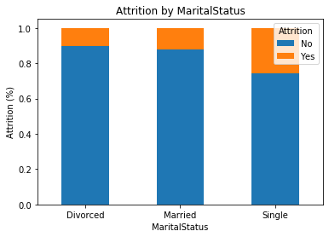
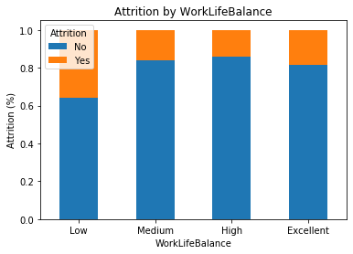
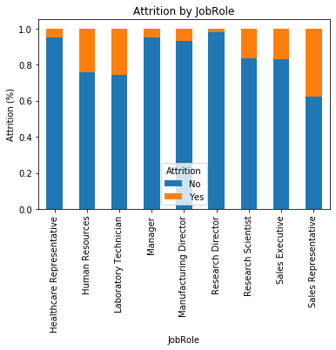
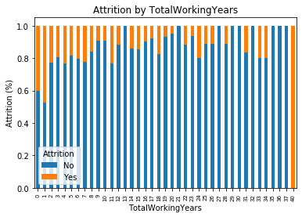

Slide 11
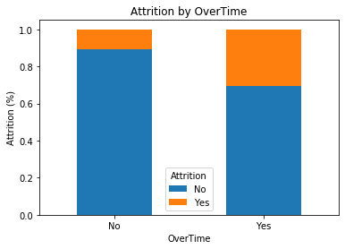

Slide 12
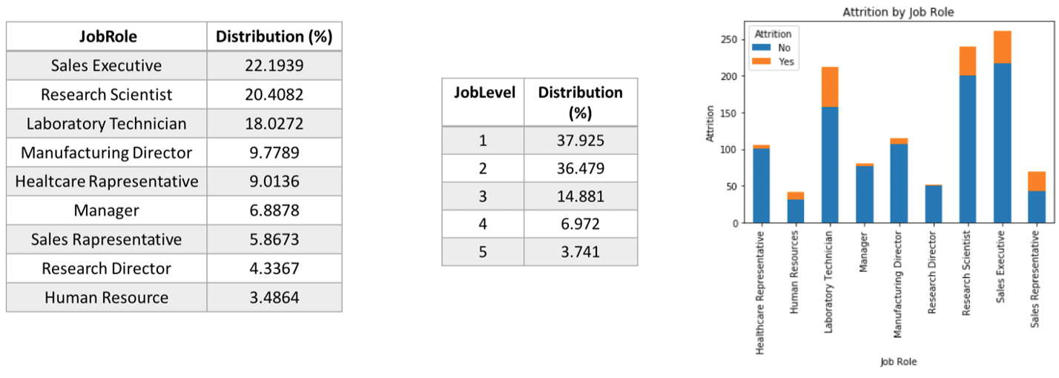

Slide 13
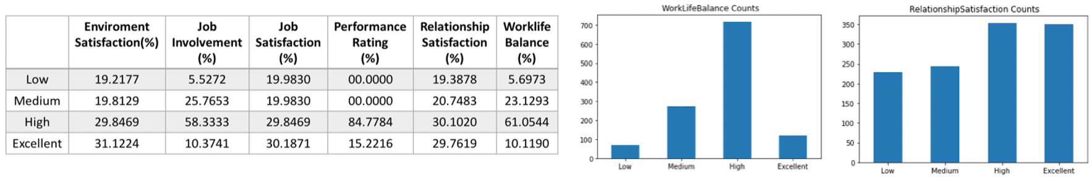

Slide 14
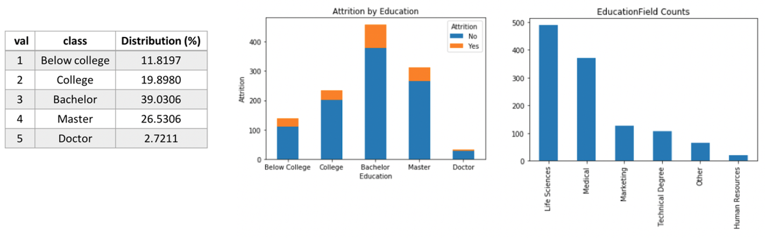

Slide 15
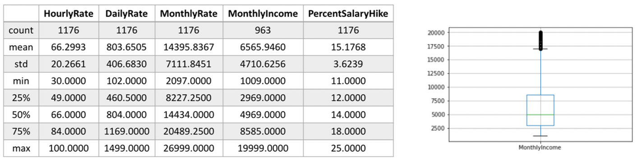

Slide 16
Clustering Technique | Clustering Quality | Silhouette Value | Number of cluster | Distance metric
K-Means | Excellent | 0.6489 | 6 | euclidean
DBScan | Poor | 0.5859 | 1 | euclidean
Hierarchical | Good | 0.5094 | 3 | euclidean

